Slide 1

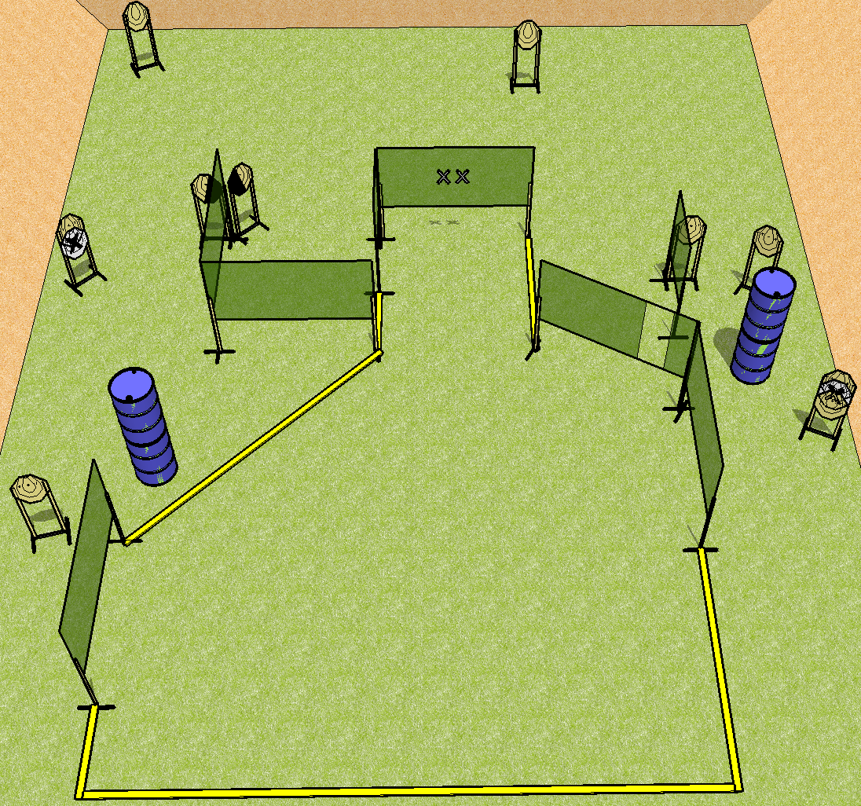
 | Dothan Practical Shooters – USPSA Match Just in Time Course Designer : Drew Coleman Bay: B3
Round Count 20 rounds 10 IPSC
Equipment List 12 wall feet 1 left + 1 right diag 10 targets (8 + 2NS)

Slide 2
Stage Name
Written Stage Briefing
Scoring: Virginia Count Rounds: 20 rounds
Targets: 10 IPSC
Handgun start position: hands touching marks. Handgun is loaded and holstered.
PCC start position: muzzle touching lower mark. Loaded carbine is held with both hands.
Stage Procedure: on the audible start signal, engage targets as they become available from within the shooting area.

